Slide 1
INFO ABOUT AV SHOES POINT
AV Shoes Point
A modern and user-friendly online shoe store.
Designed to offer stylish, comfortable, and affordable footwear.
Includes separate collections for:
✔ Men
✔ Women
✔ Kids
Features a clean UI with a hero banner, product listings, and add-to-cart functionality.
Goal: Provide a smooth online shopping experience for all age groups.

Slide 2
HOW THIS WEBSITE WAS CREATED
Technologies Used
HTML5 → For structure of the website
CSS3 → For styling, layout, responsiveness
JavaScript → For Add to Cart, Cart Modal popup, total calculation
Key Features Developed
Responsive header with navigation menu
Hero section with call-to-action
Product grid using CSS Grid
Interactive Cart system using JavaScript
Modal pop-up for viewing cart items
Smooth scroll functionality
Development Process
Designed layout using HTML
Added styling with CSS and product cards
Implemented JS functions (Add to Cart, update cart display, modal operations)
Tested responsiveness and user flow

Slide 3
WHO WILL BENIFICIES FORM THIS PROJECT
👨‍💼 Business Owners
Can showcase footwear collections online
Start an online store without high development cost
🛍️ Customers
Easy browsing of men's, women’s, and kids’ shoes
Convenient shopping experience with cart system
👩‍💻 Students & Developers
Gain experience in web development
Learn HTML/CSS/JS by building a real project
🙋‍♂️ Shop Owners
Expand beyond physical stores
Attract online customers & increase sales

Slide 4
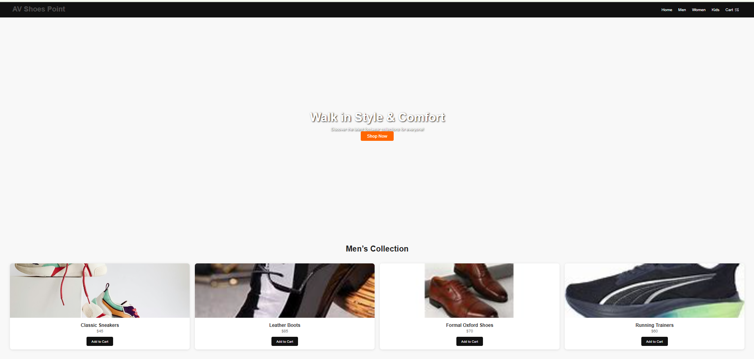
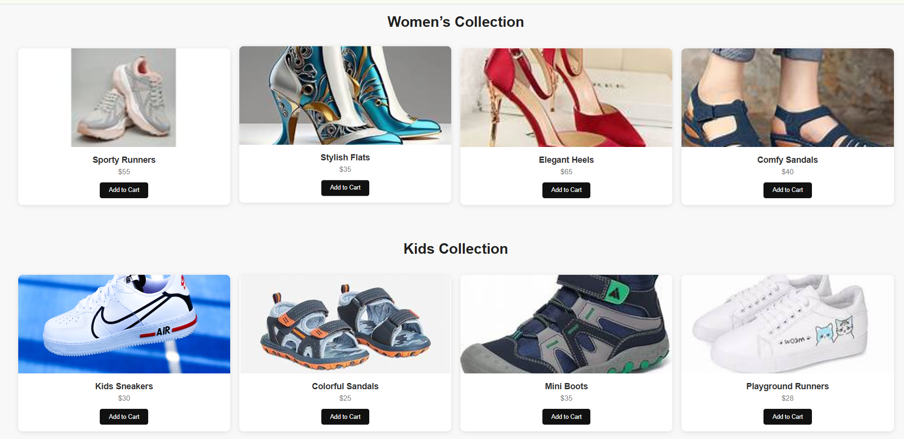
Photo of Working Website

